Slide 1
Databases and AWS
Dr. Noman Islam

Slide 2
Introduction
Almost every application relies on a database to store important data and records for its users.
A database engine allows your application to access, manage, and search large volumes of data records
RDBMS
Data warehouse
NoSQL database

Slide 3
Amazon Relational Database Service (Amazon RDS)
Amazon RDS is a service that simplifies the setup, operations, and scaling of a relational database on AWS.
With Amazon RDS, you can spend more time focusing on the application and the schema and let Amazon RDS offload common tasks like backups, patching, scaling, and replication.
Within a few minutes, Amazon RDS can launch one of many popular database engines that is ready to start taking SQLtransactions.
After the initial launch, Amazon RDS simplifies ongoing maintenance by automating common administrative tasks on a recurring basis.

Slide 4
With Amazon RDS, you can typically use the same tools to query, analyze, modify, and administer the database.
For example, current Extract, Transform, Load (ETL) tools and reporting tools can connect to Amazon RDS databases in the same way with the same drivers, and often all it takes to reconfigure is changing the hostname in the connection string.

Slide 5
Database instances
The Amazon RDS service itself provides an Application Programming Interface (API) that lets you create and manage one or more DB Instances
Amazon RDS currently supports the following database engines: MySQL, PostgreSQL, MariaDB, Oracle, SQLServer, and Amazon Aurora.
You can launch a new DB Instance by calling the CreateDBInstance API or by using the AWS Management Console.
The compute and memory resources of a DB Instance are determined by its DB Instance class.
You can select the DB Instance class that best meets your needs for compute and memory.

Slide 6
Operational benefits
Amazon RDS increases the operational reliability of your databases by applying a very consistent deployment and operational model.
If you want full control of the Operating System (OS) or require elevated permissions to run, then consider installing your database on Amazon EC2 instead of Amazon RDS

Slide 7
Licensing
Amazon RDS Oracle and Microsoft SQLServer are commercial software products that require appropriate licenses to operate in the cloud.
AWS offers two licensing models: License Included and Bring Your Own License (BYOL)
License Included In the License Included model, the license is held by AWS and is included in the Amazon RDS instance price.
In the BYOLmodel, you provide your own license.

Slide 8
Amazon Aurora
Amazon Aurora offers enterprise-grade commercial database technology while offering the simplicity and cost effectiveness of an open source database.
This is achieved by redesigning the internal components of MySQLto take a more service-oriented approach.
Amazon Aurora can deliver up to five times the performance of MySQL without requiring changes to most of your existing web applications.
You can use the same code, tools, and applications that you use with your existing MySQL databases with Amazon Aurora.

Slide 9
Storage options
Amazon RDS is built using Amazon Elastic Block Store (Amazon EBS) and allows you to select the right storage option based on your performance and cost requirements.
Depending on the database engine and workload, you can scale up to 4 to 6TB in provisioned storage and up to 30,000 IOPS
Amazon RDS supports three storage types: Magnetic, General Purpose (Solid State Drive [SSD]), and Provisioned IOPS (SSD)

Slide 10
Backup and Recovery
Amazon RDS provides a consistent operational model for backup and recovery procedures across the different database engines.
Amazon RDS provides two mechanisms for backing up the database: automated backups and manual snapshots
An automated backup is an Amazon RDS feature that continuously tracks changes and backs up your database.
In addition to automated backups, you can perform manual DB snapshots at any time. A DB snapshot is initiated by you and can be created as frequently as you want.

Slide 11
Amazon RDS allows you to recover your database quickly whether you are performing automated backups or manual DB snapshots.
You cannot restore from a DB snapshot to an existing DB Instance; a new DB Instance is created when you restore

Slide 12
High Availability with Multi-AZ
One of the most powerful features of Amazon RDS is Multi-AZ deployments, which allows you to create a database cluster across multiple Availability Zones.
Amazon RDS can increase the availability of your database using replication.
Multi-AZ allows you to place a secondary copy of your database in another Availability Zone for disaster recovery purposes

Slide 13
Scaling Up and Out
As the number of transactions increase to a relational database, scaling up, or vertically, by getting a larger machine allows you to process more reads and writes.
Scaling out, or horizontally, is also possible, but it is often more difficult.
Amazon RDS allows you to scale compute and storage vertically, and for some DB engines, you can scale horizontally.

Slide 14
Vertical Scalability
Adding additional compute, memory, or storage resources to your database allows you to process more transactions, run more queries, and store more data.
Amazon RDS makes it easy to scale up or down your database tier to meet the demands of your application
To change the amount of compute and memory, you can select a different DB Instance class of the database.
After you select a larger or smaller DB Instance class, Amazon RDS automates the migration process to a new class with only a short disruption and minimal effort.

Slide 15
Horizontal Scalability with Partitioning
A relational database can be scaled vertically only so much before you reach the maximum instance size.
Partitioning a large relational database into multiple instances or shards is a common technique for handling more requests beyond the capabilities of a single instance.
Partitioning, or sharding, allows you to scale horizontally to handle more users and requests but requires additional logic in the application layer.
The application needs to decide how to route database requests to the correct shard and becomes limited in the types of queries that can be performed across server boundaries.
NoSQLdatabases like Amazon DynamoDB or Cassandra are designed to scale horizontally.

Slide 16
Horizontal Scalability with Read Replicas
Another important scaling technique is to use read replicas to offload read transactions from the primary database and increase the overall number of transactions.
Amazon RDS supports read replicas that allow you to scale out elastically beyond the capacity constraints of a single DB Instance for read-heavy database workloads

Slide 17
Security
Protect access to your infrastructure resources using AWS Identity and Access Management (IAM) policies that limit which actions AWS administrators can perform.
Another security best practice is to deploy your Amazon RDS DB Instances into a private subnet within an Amazon Virtual Private Cloud (Amazon VPC) that limits network access to the DB Instance
Further, restrict network access using network Access Control Lists (ACLs) and security groups to limit inbound traffic to a short list of source IP addresses

Slide 18
At the database level, you will also need to create users and grant them permissions to read and write to your databases.
Finally, protect the confidentiality of your data in transit and at rest with multiple encryption capabilities provided with Amazon RDS.

Slide 19
Amazon Redshift
Amazon Redshift is a fast, powerful, fully managed, petabyte-scale data warehouse service in the cloud.
Amazon Redshift is a relational database designed for OLAP scenarios and optimized for high performance analysis and reporting of very large datasets
Amazon Redshift gives you fast querying capabilities over structured data using standard SQL commands to support interactive querying over large datasets
With connectivity via ODBC or JDBC, Amazon Redshift integrates well with various data loading, reporting, data mining, and analytics tools

Slide 20
Clusters and Nodes
The key component of an Amazon Redshift data warehouse is a cluster.
A cluster is composed of a leader node and one or more compute nodes.
The client application interacts directly only with the leader node, and the compute nodes are transparent to external applications.
Amazon Redshift currently has support for six different node types and each has a different mix of CPU, memory, and storage.
The six node types are grouped into two categories: Dense Compute and Dense Storage.
The Dense Compute node types support clusters up to 326TB using fast SSDs, while the Dense Storage nodes support clusters up to 2PB using large magnetic disks

Slide 21
Each cluster contains one or more databases.
User data for each table is distributed across the compute nodes.
Your application or SQLclient communicates with Amazon Redshift using standard JDBC or ODBC connections with the leader node, which in turn coordinates query execution with the compute nodes.
Your application does not interact directly with the compute nodes.

Slide 22
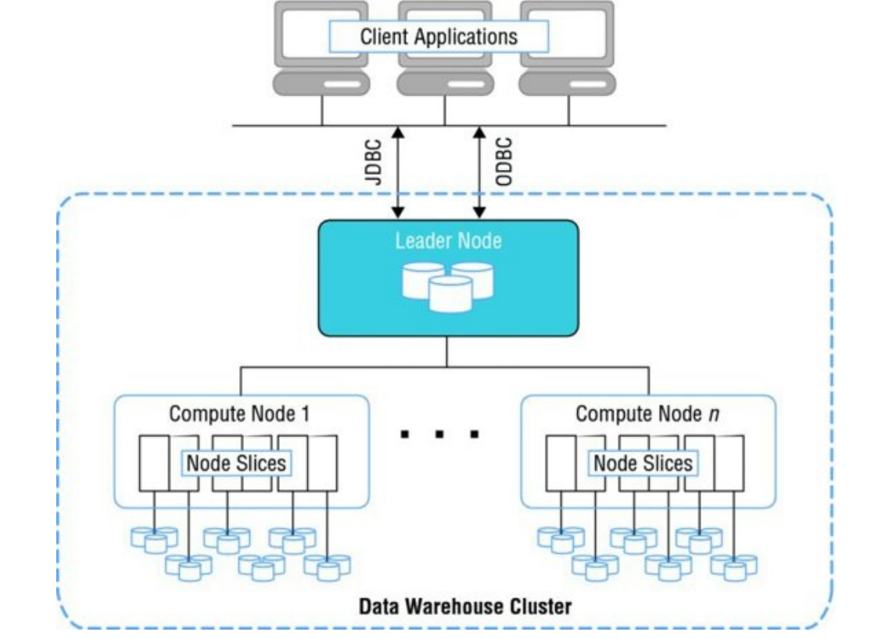

Slide 23
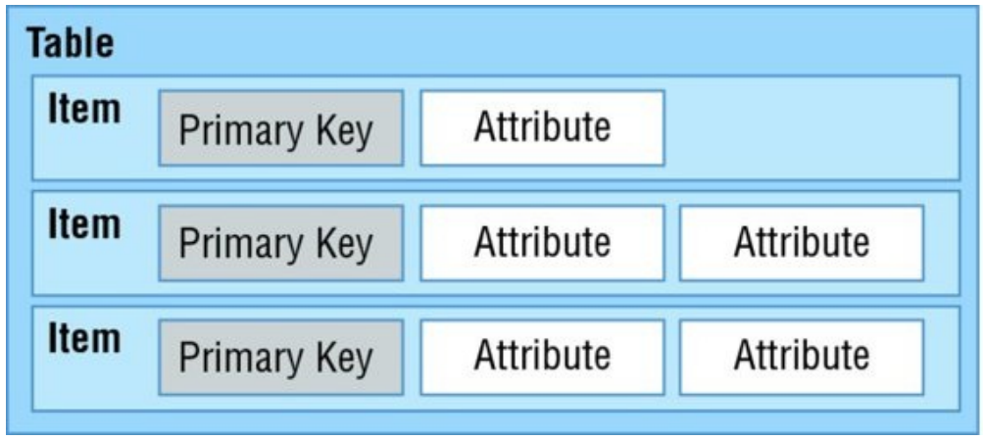
Amazon DynamoDB
Amazon DynamoDB is a fully managed NoSQLdatabase service that provides fast and low-latency performance that scales with ease.
Amazon DynamoDB can provide consistent performance levels by automatically distributing the data and traffic for a table over multiple partitions

Slide 24
Amazon DynamoDB only requires that a table have a primary key, but it does not require you to define all of the attribute names and data types in advance.
Individual items in an Amazon DynamoDB table can have any number of attributes, although there is a limit of 400KB on the item size.
Each attribute in an item is a name/value pair.
An attribute can be a single-valued or multi-valued set.
For example, a book item can have title and authors attributes.
Each book has one title but can have many authors.
The multi-valued attribute is a set; duplicate values are not allowed

Slide 25
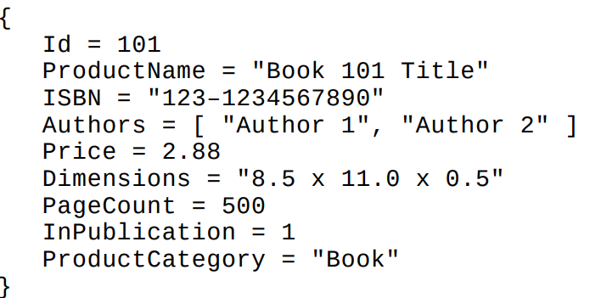

Slide 26
Applications can connect to the Amazon DynamoDB service endpoint and submit requests over HTTP/S to read and write items to a table or even to create and delete tables
DynamoDB provides a web service API that accepts requests in JSON format

Slide 27
Secondary indexes
When you create a table with a partition and sort key (formerly known as a hash and range key), you can optionally define one or more secondary indexes on that table.
A secondary index lets you query the data in the table using an alternate key, in addition to queries against the primary key.
Amazon DynamoDB supports two different kinds of indexes:
Global Secondary Index: The global secondary index is an index with a partition and sort key that can be different from those on the table. You can create or delete a global secondary index on a table at any time.
Local Secondary Index: The local secondary index is an index that has the same partition key attribute as the primary key of the table, but a different sort key. You can only create a local secondary index when you create a table.

Slide 28
Eventual Consistency
When reading items from Amazon DynamoDB, the operation can be either eventually consistent or strongly consistent.
Amazon DynamoDB is a distributed system that stores multiple copies of an item across an AWS Region to provide high availability and increased durability.
When an item is updated in Amazon DynamoDB, it starts replicating across multiple servers. Because Amazon DynamoDB is a distributed system, the replication can take some time to complete.

Slide 29
Because of this we refer to the data as being eventually consistent, meaning that a read request immediately after a write operation might not show the latest change.
In some cases, the application needs to guarantee that the data is the latest and Amazon DynamoDB offers an option for strongly consistent reads.

Slide 30
Batch Operations
Amazon DynamoDB also provides several operations designed for working with large batches of items
This allows you to minimize the overhead of each individual call when processing large numbers of items.

Slide 31
Amazon DynamoDB Streams
A common requirement for many applications is to keep track of recent changes and then perform some kind of processing on the changed records.
Amazon DynamoDB Streams makes it easy to get a list of item modifications for the last 24-hour period
Each item change is buffered in a time-ordered sequence or stream that can be read by other applications. C
hanges are logged to the stream in near real-time and allow you to respond quickly or chain together a sequence of events based on a modification

